Slide 1

JAN. 22, 2020 • ANDREW
Analytics and Marketing
@Meltwater Entrepreneurial School of Tech
Developing an Analytic Strategy for your Product

Slide 2

OUTLINE
WW-Learn
What is Analytics
History
Importance
Types of Product Analytics
Things to Look out for
Toolsets and Analytic Products
Utilizing a CDP & Tag Manager
Why use a CDP?
What to Measure
Setting Up a Tracking Plan
Getting Started
Data Compliance & GDPR
History

Slide 3

Modern Data Storage
A WORLD BEFORE THE DATA
Interviewed by Colliers magazine, inventor Nikola Tesla states that when wireless technology is “perfectly applied the whole Earth will be
converted into a huge brain, which in fact it is, all things being particles of a real and rhythmic whole … and the instruments through which we shall be able to do this will be amazingly simple compared to
our present telephone. A man will be able to carry one in his vest pocket.”

Slide 4

What is Analytics
Analytics is the discovery, interpretation, and communication of meaningful patterns in data. It also entails applying data patterns towards effective decision making. In other words, analytics can be understood as the connective tissue between data and effective decision
making within an organization
DATA - DECISION - ACTION

Slide 5
Why do you need Analytic
JUST #FINK ABOUT IT

Slide 6



Google
Track & Measure ROI
Youtube
BASED ON YOUR SOCIAL MEDIA CAMPAIGN
Facebook

Slide 7
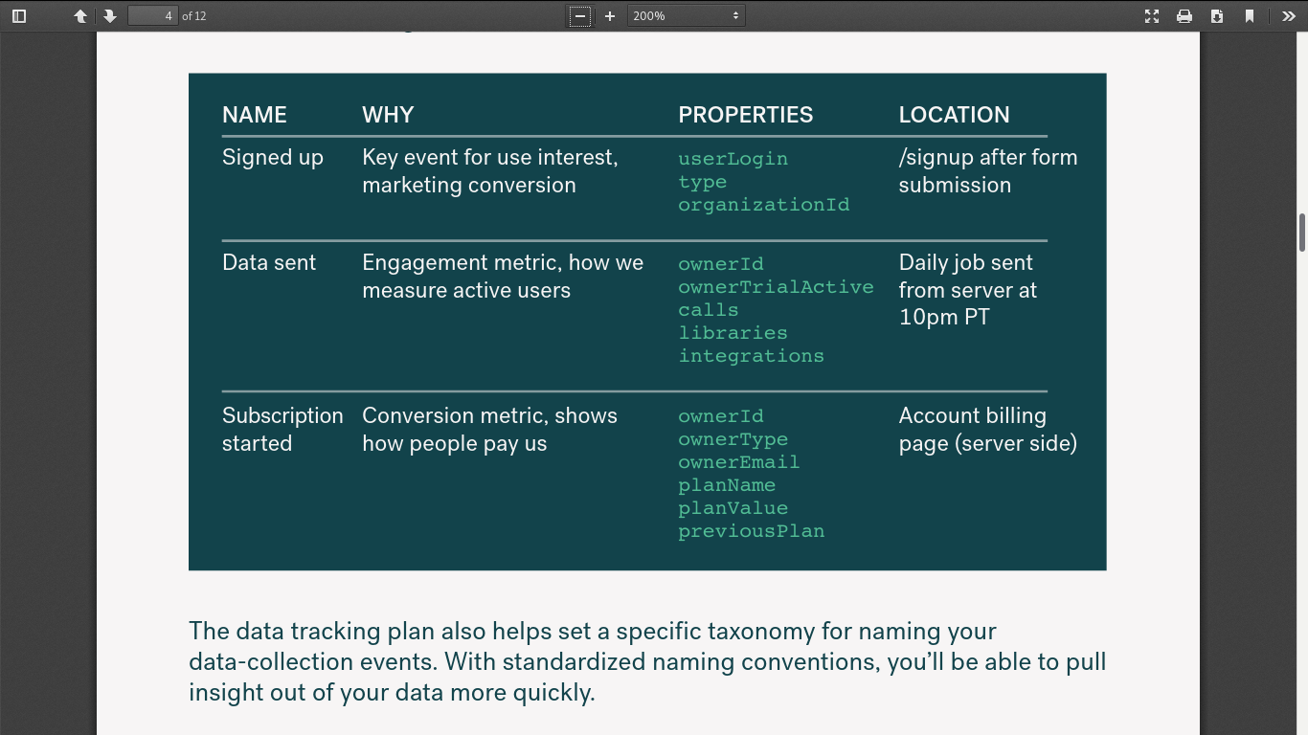

Slide 8


Setting Up a Tracking Plan
How to Begin
Comstech • Oct. 15, 2020

Slide 9
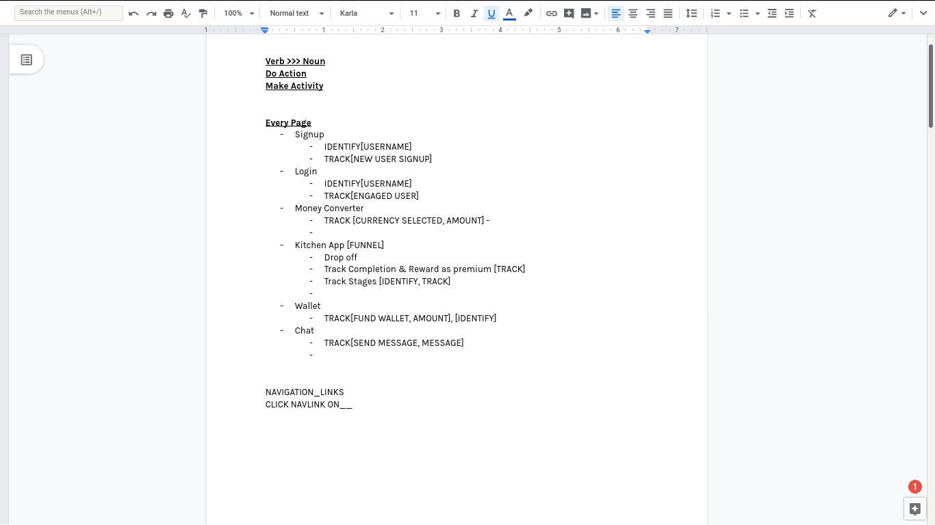

Slide 11
Analytic Toolset & Options
Google Analytics
Segment
Amplitude
Hotjar
Mailchimp
Comstech • Oct. 15, 2020

Slide 12
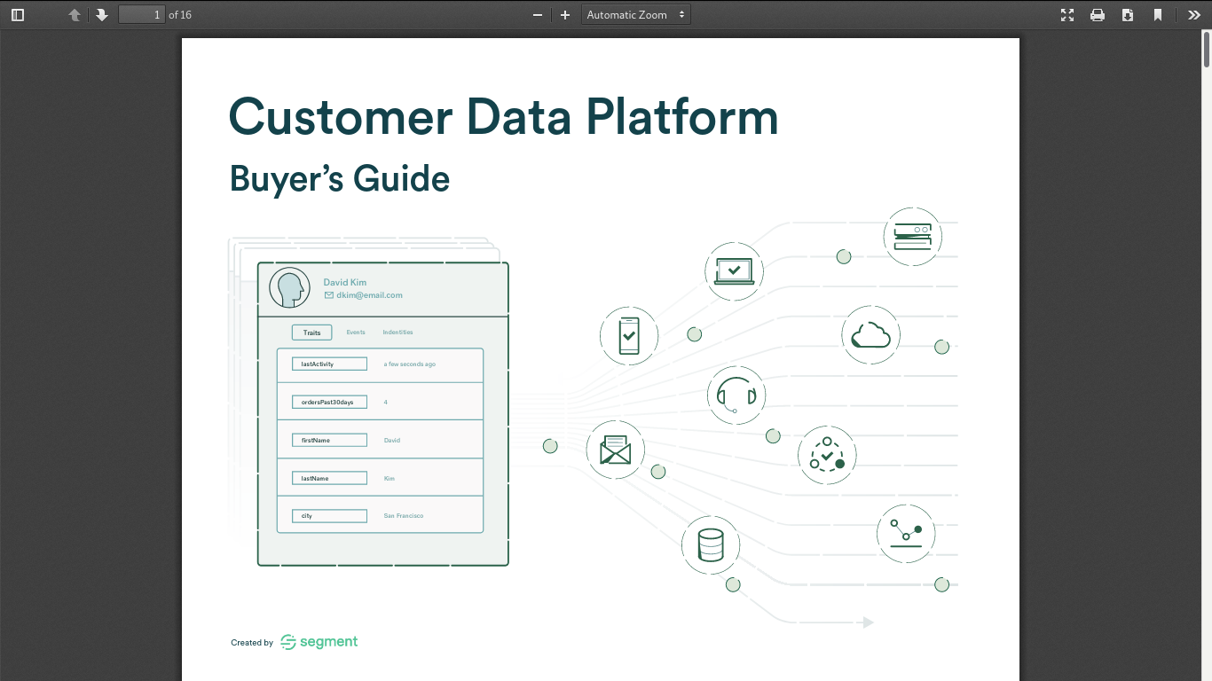

Slide 13
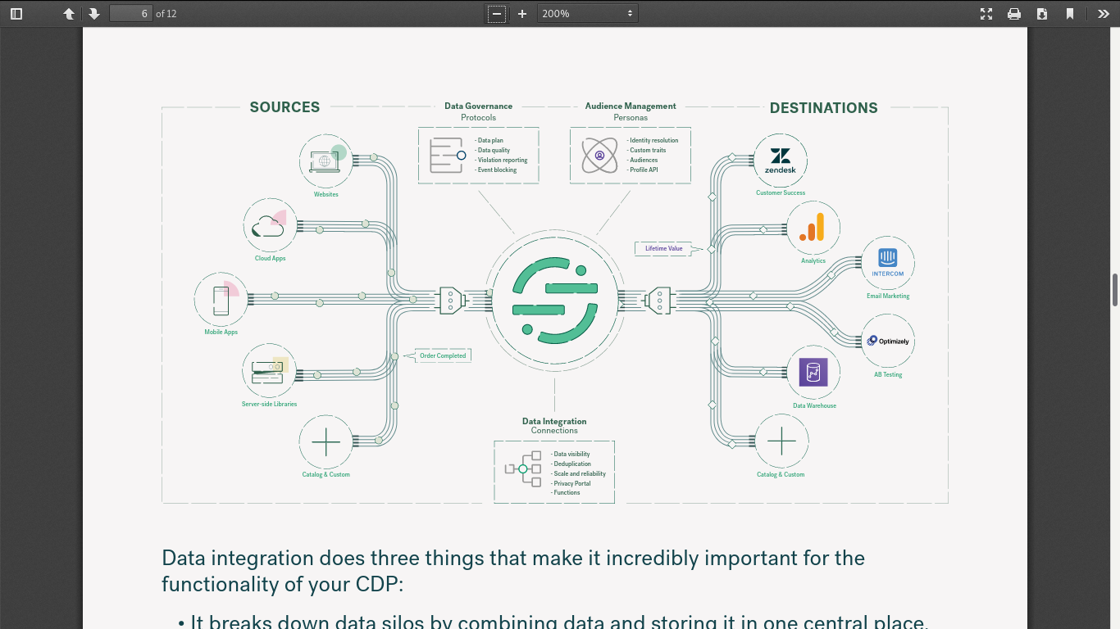

Slide 14

UTM MEDIUMS
REFERRERS
Tracking with UTM Tags
Enhanced Link Attribution
Effective Tracking

Slide 15
Data Privacy & GDPR
Data Security is important
Comstech • Oct. 15, 2020

Slide 16
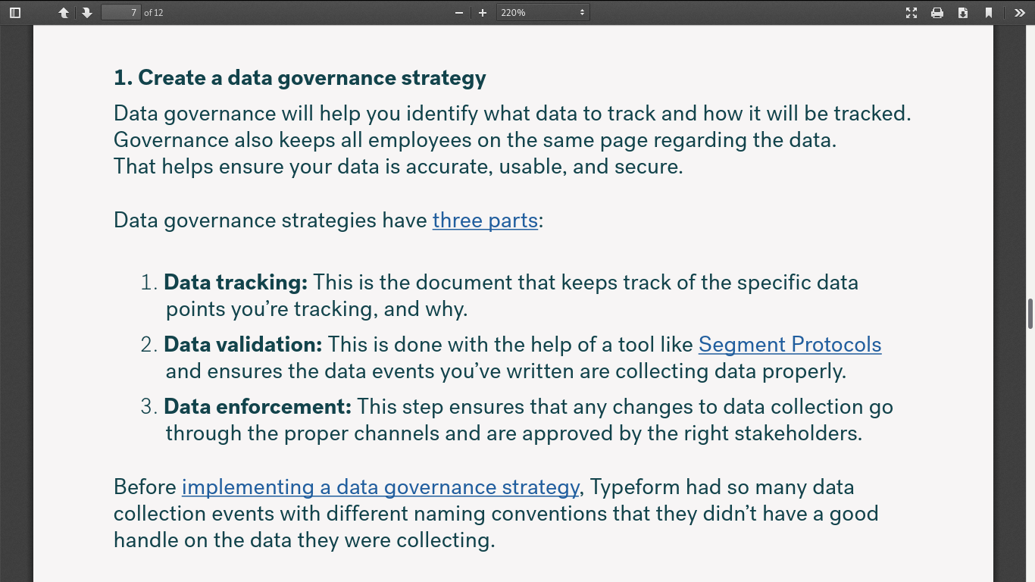

Slide 17
Usage Milestones
WHAT?
HOW?
---
---
WHERE ?
WHEN?
---
All you need about wh
Comstech • Oct. 15, 2020

Slide 18
ACCORDING TO REGION
Presentations are tools that can be used as lectures.
Positive Effects of the Internet
DIGITAL DIVIDE
Presentations are tools that can be used as lectures.
ONLINE BULLYING
Presentations are tools that can be used as lectures.
Comstech • Oct. 15, 2020

Slide 19
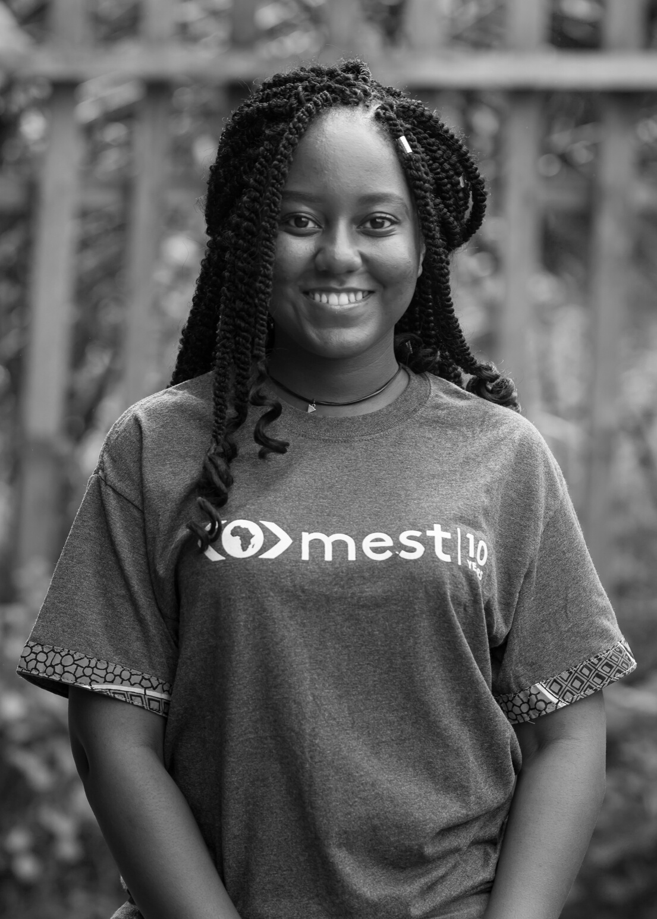
Thank You
LADY DZIDJOR
Testing

Slide 20
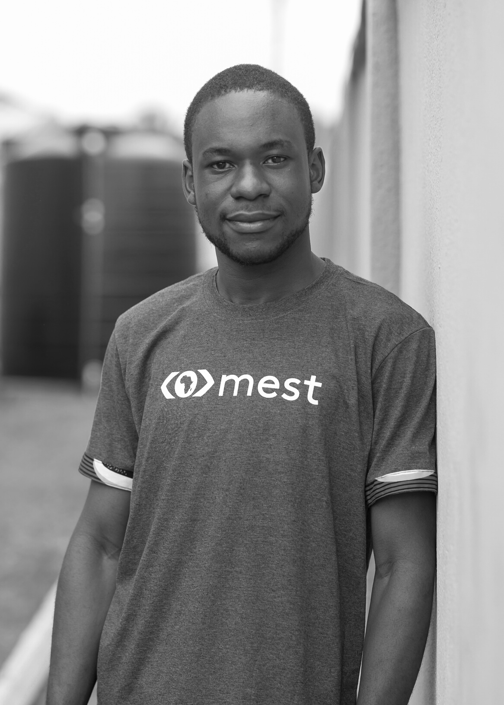
Thank You
MICHAEL HAMMOND
Ninja Developer

Slide 21
Other Resources
Comstech • Oct. 15, 2020
ONLINE CONNECTIVITY

Slide 23
SOMETHING TO FINK ABOUT
Analytics is not a luxury, it is a necessity.

